Slide 1
Presented by: Carly Beneteau, Program Manager
www.boundlessaccelerator.ca

Slide 2
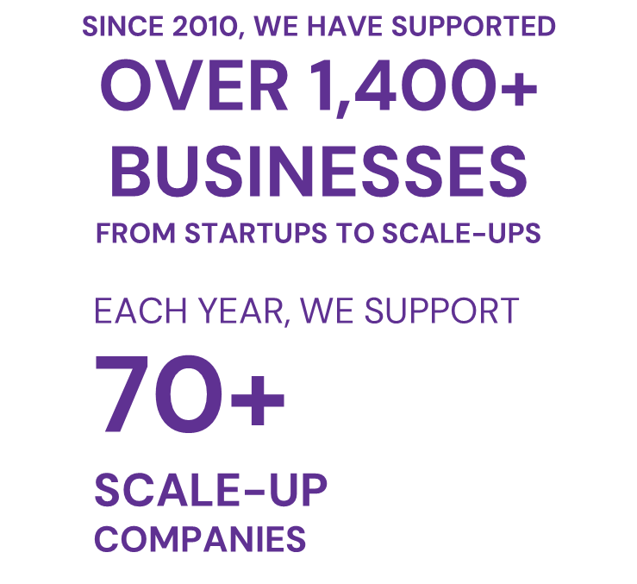
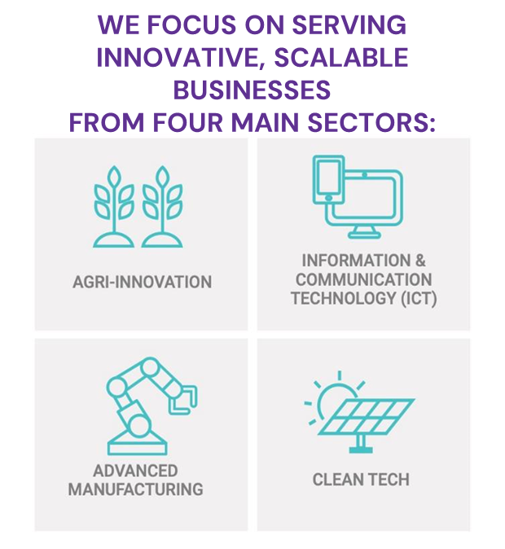
Notes:
In case some of you are new to us, Boundless Accelerator was established in 2010 as Innovation Guelph and is one of 17 Regional Innovation Centres in Ontario. We are proud to share with you that we won many awards for our leadership in advancing Canadian entrepreneurship across the country.
While we are located in Guelph Ontario, we serve the entire region of Southern Ontario and have a national program. This means that while MOST of our clients are located within the Toronto to Waterloo corridor, we have clients in BC all the way to Nova Scotia and throughout most of Ontario.
We work with our clients, supporting them throughout multiple stages of business GROWTH, from startup to scaleup, with many programs and workshops, networking opportunities and professional introductions. Our team consists of 40 mentors/industry specialists
More information can be found on our website at www.boundlessaccelerator.ca.

Slide 3
Our Programs (ongoing intake)
Companies In Ontario
Pre-revenue to up to $1 million
Past the ideation stage
Delivered through education, networking, strategic introductions, mentorship, and more!
National accelerator for scaling women led/founded companies
Generating $200,000 or more in revenue
Support through mentorship, hands-on project work, leadership coaching, and education.
Notes:
Startup Program – supporting through education, mentorship, opportunities for project work – companies in Ontario from pre-revenue to $1 million, past the ideation stage
Rhyze Up! – national program for women entrepreneurs to help scale – minimum revenue $200K. Delivered through mentorship, hands-on project work, leadership coaching, and education.

Slide 4
Our Programs
(cohort based)
Investment readiness education program for early-stage founders in Ontario (hybrid)
Investment readiness education for women entrepreneurs in food processing (national, online)
Online training course for individuals who want to upskill to sales roles in the Cleantech industry.
Or for employers who have professional development funds to train their staff
Notes:
Quantum Drive – supports early-stage founders in investment readiness through education, mentorship and culminates in a pitch to an expert pitch panel and investors
Venture Capital Ready - Delivered in partnership with the Small Scale Food Processing Association (SSFPA). For women/women identifying entrepreneurs in the food processing industry (or companion sectors), providing investment readiness education. Free online program.
Grow With Cleantech - online 16-week training course for individuals who want to upskill to sales roles in the Cleantech industry. Valued at $5000, offered to individuals for $500 + HST
Closed:
i.d.e.a. Fund – supporting a diverse, green economy, Any stage, Seed funding up to $30K with matching funds. Just won the 2023 TECNA Innovation Award for Diversity, Equity and Inclusion.

Slide 5
Ongoing mentor support
Tailored short term projects
Fractional work
Specialized packages tackling:
Marketing
Business Strategy
Business Development/Sales
And more!
Notes:
Boundless Business Consulting is a vision of Boundless Accelerator and supports entrepreneurs who are struggling to scale their business to $1 million+ by delivering high-value business consulting offerings that will take their business to the next level and address their toughest business challenges.
Our team of experienced executives and seasoned business consultants will partner with SMEs to identify any roadblocks to success and help them find growth opportunities, build momentum and accelerate results.
Each engagement is tailor-made to suit the needs of the company.
Over 40 experts their fields who are contracted to BA and deliver exceptional mentorship and project implementation
Great value
Examples:
Business Management and Strategy
Technical Expertise Development (IT or Engineering)
Leadership Training
Talent Recruitment
Branding and Marketing
Process Efficiency and Optimization
New Product Development
Prototyping and Product Piloting
B2B Sales and Business Development
Investment Readiness and Preparation
Advisory Board
Fractional HR/CFO/COO support

Slide 6
2023-2024 Impact
290 unique clients supported
with 80 being new
68% of businesses supported were women-led
$15.4M in total investments received
504 opportunities shared
(networking, education, gov’t engagement)
7,320 mentorship hours provided
PLUS 131 hours volunteer time
115 products, services, or technologies launched
Notes:
This is all clients, not just ON
261 companies in ON
65% women led
482 Opportunities
5310 mentor hours
ON $13.6M investments
101 IP
Investments – highest was personal ($5.6), government funding ($2.7), VC ($1.8), angel investment ($1.5), other ($1.4), bank loan

Slide 7
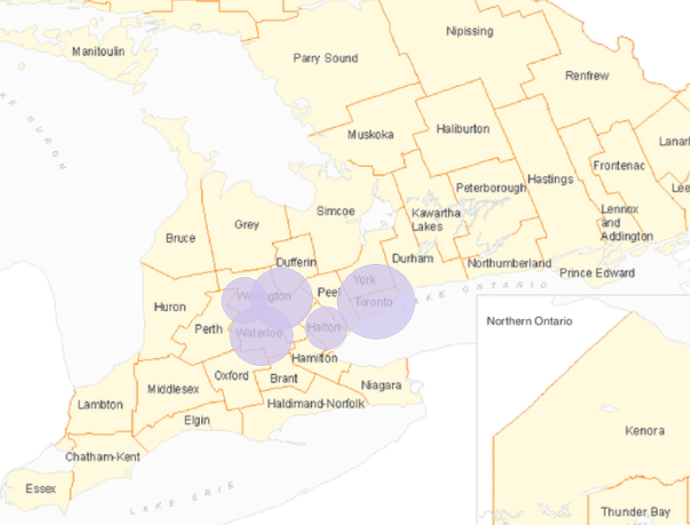
Client Distribution by Region
5 regions account for 63% of our clients (FY 2024):
Toronto: 20%
Waterloo: 16%
City of Guelph: 16%
Halton: 6%
Wellington County
(excl. Guelph): 5%
Notes:
Not applicable (I.e. outside of Ontario) – 10%
Peel – 3%
York – 3%
Ottawa – 3%
Etc.

Slide 8
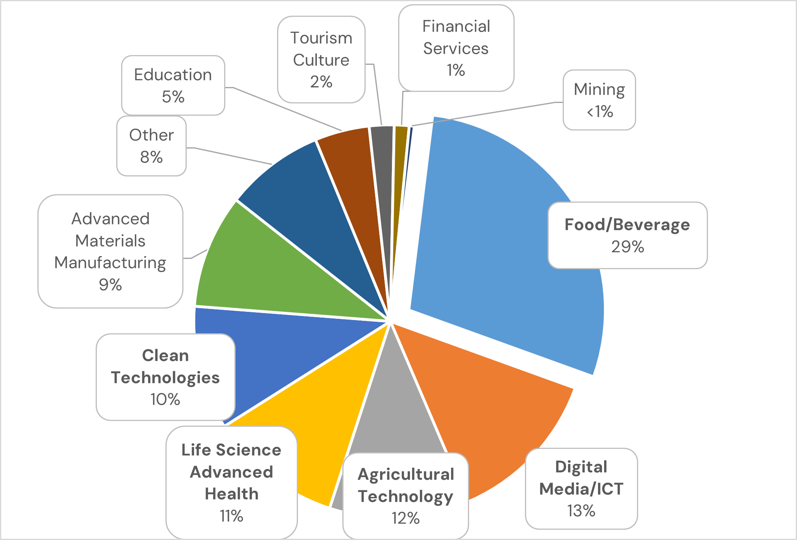
Client Distribution by Industry
Top Industries (Ontario only):
Food/Beverage – 29%
Digital Media/ICT – 13%
Ag Tech – 12%
Life Sci/Advanced Health – 11%
Clean Tech – 10%

Slide 9
info@boundlessaccelerator.ca or 519-265-4495
www.boundlessaccelerator.ca

